Slide 1

VIETNAM NATIONAL UNIVERSITY
BACH KHOA UNIVERSITY
ASSIGNMENT:
IMPLEMENT NEURAL NETWORK WITH IPYTHON
CHUNG THANH MINH
SUPERVISOR: DR. LE THANH SACH

Slide 2
IPython
The Jupyter Notebook
The Jupyter Notebook is an opensource web application that allows you to create and share documents that contain live code, equations, visualizations and explanatory text
Notes:
HPC hien nay dang rat pho bien va nhung loi ich cua mang lai rat lon; dien hinh la viec cung cap tai nguyen tinh toan cho nhieu loai ung dung, nhieu loai user khac nhau

Slide 3
Tutorial for IPython
Prerequisite: Python
1. Installing Jupyter using Anaconda and conda
For new users, highly recommend installing Anaconda. Anaconda conveniently installs Python, the Jupyter Notebook, and other commonly used packages for scientific computing and data science.
Download Anaconda
To run the notebook: jupyter notebook
2. Installing Jupyter with pip
Ensure that you have the latest pip; older versions may have trouble with some dependencies: pip3 install --upgrade pip
Then install the Jupyter Notebook using: pip3 install jupyter
Notes:
Multicore vs Manycore

Slide 4
Introduction
Heterogeneous System: CPU – Intel Xeon Phi
Programming Models
1. Native Execution
Program running …
Notes:
Gioi thieu so qua ve 2 mo hinh lap trinh chinh va cach chay ung dung tren Xeon Phi:
Native: su khac biet lon giua GPU va Xeon Phi la mo hinh lap trinh. Xeon Phi muon pho bien ve mat phat trien ung dung; do do gan nhu cac source cua chuong trinh bat ky ko can phai thay doi nhieu trong viec chay tren no.
Native mode: chuong trinh duoc viet va compile duoi host. Sau do file thuc thi can duoc upload vao xeon phi. Va cuoi cung, user can ssh vao Xeon Phi va chay xem nhu la mot node doc lap.

Slide 5
Introduction
Heterogeneous System: CPU – Intel Xeon Phi
Programming Models
2. Offload Execution
Notes:
- Offload: chuong trinh duoc viet, compile va thuc thi duoi host.

Slide 6
Introduction
Heterogeneous System: CPU – Intel Xeon Phi
Programming Models
2. Offload Execution
Notes:
Binh thuong chuong trinh se thuc thi duoi host, doan code nao duoc offload se thuc thi tren Xeon Phi

Slide 7
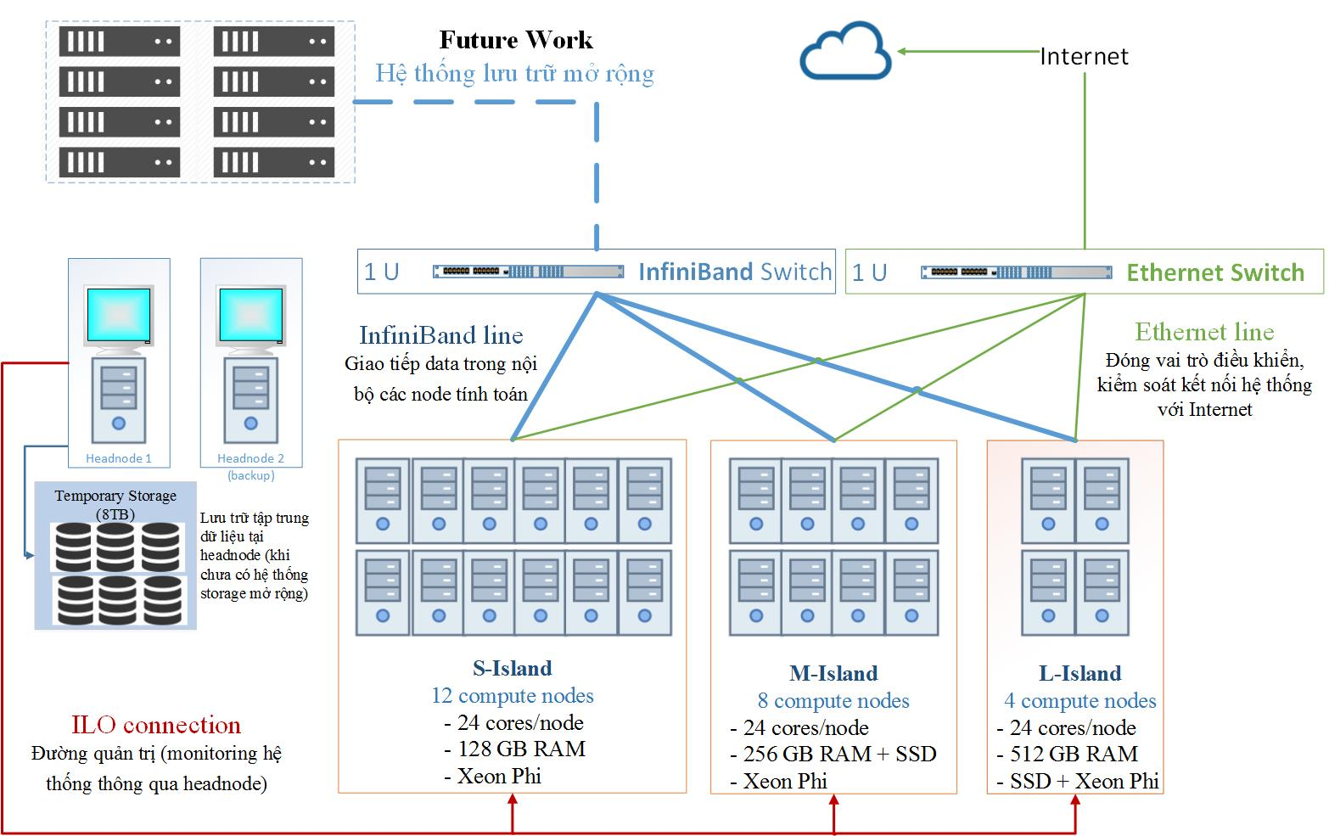
Motivation SuperNode-XP
Scheduler?
user1
user2
user3
user4
user5
usern
CPU/Data Intensive Apps
Dynamic Apps
Problems in Heterogeneous System: providing resources for users
Notes:
Van de dat ra: hien tai minh dang co 1 he thong gom 24 node tinh toan, trong do duoc chia thanh 3 cum may voi cau hinh khac nhau. Moi node tinh toan gom 2 CPU va 2 Xeon Phi. He thong hien dang duoc su dung de ho tro cap phat tai nguyen cho nhieu nhom nhieu cuu khac nhau, nhieu loai ung dung khac nhau.
Trong do, chung duoc phan thanh 2 nhom chinh: CPU/Data intensive apps vs Dynamic Apps
Neu he thong chi don thuan phuv vu 1, 2, 3 user khac nhau thi khong co nhieu van de o day, nhung khi so luong user tang len thi scheduler thich hop la 1 yeu to quan trong. Do cung la van de dat ra thu nhat, lam sao he thong co the dap ung cac user co du tai nguyen su dung, khong bi tranh chap voi vung tai nguyen cua user khac. Thu hai, dung ve phia he thong lam sao co the cap phat tai nguyen 1 cach hieu qua va tiet kiem.

Slide 8
Motivation SuperNode-XP
Dispatch
Scheduler?
user1
user2
user3
user4
user5
usern
CPU/Data Intensive Apps
Dynamic Apps
User 3
User 2
Xeon Phi as a separate node
Problems in Heterogeneous System: providing resources for users
Notes:
Van de thu 2, cung la moi quan tam chinh cua de tai: khi ung dung co nhu cau su dung khong chi CPU ma ca Xeon Phi thi mot giai phap lap lich nhu the nao la hop ly.
Hien nay, neu job duoc thuc thi theo co che Native: neu tong so luong core ma user 2 va user 3 yeu cau lon hon tong so core cho phep cua Xeon Phi thi se gay ra hien tuong overscription.

Slide 9
Motivation SuperNode-XP
Scheduler?
user1
user2
user3
user4
user5
usern
CPU/Data Intensive Apps
Dynamic Apps
Xeon Phi as an accelerator
Problems in Heterogeneous System: providing resources for users
Notes:
Tuong tu, hien tuong overscription cung xay ra voi co che thuc thi Offload

Slide 10
Related Works Overview
Some Specific Studies [1]: Workload Characterization, Scheduling in Practice, Thread-oriented Scheduling, Load-based Scheduling, Non-work-conserving Scheduling, Time-slicing and Space-slicing Scheduling, Knowledge-based Scheduling.
Scheduling Solutions on Heterogeneous Systems: most of the past work on coprocessor sharing focused on sharing GPUs between user processes or Virtual Machine [2].
Scheduling policies on a Cluster of CPU-GPU Nodes [3]
+ Scheduling of Single Node Jobs:
1. Relative Speedup Based
2. Adaptive Shorted Job First
+ Scheduling of Multi-Node Jobs:
1. Flexible Moldable Scheduling Scheme
Notes:
Relative Speedup Based: This scheme operate on batches of N jobs, It first create 2 job queues (CJQ) and (GJQ) that contain the jobs that report better speed up on the CPU and GPU. Each of these queues is sorted in descending order with respect to the difference in performance. This difference in performance is used as an indicator as to where non-optimal placement.
Adaptive Shortest Job First: require CPU execution time of each job being submitted. This information enhance version of Relative Speed Up

Slide 11
Related Works A Dynamic Offload Scheduler [4], 2014
The task level scheduler
Low processor utilization problem scheduled with partitioning resources per task statically
Notes:
Van de cua cong trinh nay dua ra xoay quanh van de offload cua Xeon Phi: tuc khi task 1 va task 2 cung co nhu cau offload len Xeon Phi. Theo scheduler mac dinh thi se chia core cho task1, task2. Nhung gioi han nam o cho thoi gian idle cua CPU va Xeon Phi khi job luc thi thuc thi tren CPU, luc thi thuc thi tren Xeon Phi.
Nhom nghien cuu da dua ra giai phap dua tren y tuong giai quyet dong bo o OS, tuong tu nhu co che lock unlock cua semaphore. Trong chuong trinh chinh. Chuong khi goi directive offload, phai goi API() duoc dinh nghia truoc de yeu cau tai nguyen tren XeonPhi, va khi thuc thi xong thi tra lock tro lai.

Slide 12
Related Works A Dynamic Offload Scheduler
A flowchart of the dynamic offload scheduler which cooperates with a task
A comparison between the task level scheduler and the dynamic offload scheduler for a processor utilization of Xeon Phi
Notes:
- Advantages:
Disadvantages: + Only Offload? + Only Processor Resource – Mem? Starvation?....

Slide 13
Related Works COSMIC [5], 2014
The COSMIC system: manages offloads from host processes to several different coprocessors.
Notes:
COSMIC: y tuong nam o mo hinh hien thuc COSMIC nhu mot software stack nam giua host va Xeon Phi. Tat ca cac job submit deu phai thong qua COSMIC de duoc cap phat den MIC thich hop

Slide 14
Related Works COSMIC
The COSMIC Software Architecture: the client, the scheduler, the monitor
1. The COSMIC Client: The client intercepts COI calls and communicates with the scheduler for coprocessor resources.
2. The COSMIC Scheduler: manages multiple user processes, offloads and several coprocessor devices, and arbitrates access to all coprocessor resources.
3. The COSMIC Monitor: collects data about the state of the coprocessors.
Notes:
The figure shows three coprocessors each with a different number of cores and memory. A host process contains several offload blocks that are executed sequentially. Every offload can have its unique thread and affinity requirement.
Note offloads from the same process often share data in order to reduce unnecessary data movement between the host and Xeon Phi (data persistence).
However, unlike cluster schedulers, COSMIC does not require the process to specify the number of cores or devices. Rather, it automatically infers such information from the number of threads requested by the offload.

Slide 15
Related Works COSMIC
The COSMIC Scheduler:
The scheduler is event-based.
A scheduling cycle is triggered by a new event that can be the arrival of a new process, the arrival of a new offload in an existing process, the dispatching of an offload to a Xeon Phi device, the completion of an offload or the completion of a process.
COSMIC scheduling procedure
First-fit aging algorithm for process scheduling
Notes:
The figure shows three coprocessors each with a different number of cores and memory. A host process contains several offload blocks that are executed sequentially. Every offload can have its unique thread and affinity requirement.
Note offloads from the same process often share data in order to reduce unnecessary data movement between the host and Xeon Phi (data persistence).
However, unlike cluster schedulers, COSMIC does not require the process to specify the number of cores or devices. Rather, it automatically infers such information from the number of threads requested by the offload.

Slide 16
Related Works Semi-Automatic Restructuring of Offloadable Tasks, 2015
The parallel loop by itself is not the best candidate for offload, just the most obvious one; and that a better candidate would be the subloop obtained by splitting the index range of the parallel loop into two parts.
Contribution is the idea of sub-offload and super-offload.
+ In sub-offload, only part of the code region marked by the developer is offloaded to the accelerator, while the other part executes on the CPU in parallel.
+ In super-offload, a code region larger than the one specified by the developer is declared as the offloadable task.
CPU idle time and data transfer time as fractions of total execution time when using Xeon Phi (MIC)
Notes:
Tai cau truc lai co che offload cua Xeon Phi, them vao 2 directive moi. Bai toan dat ra cua cong trinh nay la viec quan sat: su han che cua co che offload truyen thong chi don thuan la danh dau vung code do se duoc offload len Xeon Phi. Tuy nhien, tac gia nhan thay, gia su neu toan bo mot vong lap nao do duoc offload len Xeon cung chuan hoan toan thuc thi hieu qua va dem lai hieu suat tot. Qua do, o cac directive lap trinh moi cho phep nguoi lap trinh danh dau nhung vung code nhat dinh se duoc offload len Xeon Phi, dong thoi co kha nang tuning va optimize vung code de dat duoc hieu suat cao.
Y tuong tai cau truc lai mo hinh lap trinh gop phan tuning so core can de thuc thi hieu qua tren Xeon Phi, de ho tro cho chinh sach cap phat tai nguyen.

Slide 17
Related Works Snaptify: Capturing Snapshots of Offload Apps, 2014
The core technique of Snapify is to take consistent process snapshots of the communicating offload processes and their host processes. It provides three novel features for Xeon Phi offload applications:
+ checkpoint and restart
+ process swapping
+ process migration
The architecture of Snapify
Overview of taking a snapshot
Notes:
Snaptify: gop phan capture snapshot cua nhung job duoc Offload len Xeon Phi. Muc dich chinh cua cong trinh la ho tro viec checkpointing, swapping process va migrate process den Xeon Phi khac nhau.
Nham ho tro cho co che lap lich can su migrate giua cac process.

Slide 18
Related Works Efficient Query Processing on Many-Core Arc, 2016
With the trend towards many-core architectures, query operator optimizations, and efficient query scheduling on such many-core architectures remain as challenging issues.
PhiDB has 5 main components:
+ Query Parser
+ Query Optimizer
+ Query Execution Scheduler,
+ Thread Pool
+ Query Processing Engine
System overview of PhiDB
Notes:
The query parser translates input queries into the logical query plan.
The query optimizer tunes the concurrency level (the number of threads used) for each operator according to which operators are further divided into jobs. A job is to be executed by a single thread and it contains necessary information such as the assigned partition of input relations for the execution. The optimizer also decides which pairs of operators are to be executed con- currently and generates the final optimized scheduling plan.
The query execution scheduler maintains a queue of operators according to such plan.
In the thread pool, a thread pulls this queue for the next job when it becomes free and it executes the query engine to process each job.
The query en- gine is divided into three layers: operators, access methods and the storage.

Slide 19
Related Works Similarity (range and kNN) queries processing on Xeon Phi, 2016
The paper implements and compares different exhaustive and indexing algorithms to solve similarity queries (kNN and range queries) on an Intel Xeon Phi coprocessor.
Exhaustive algorithms solving range queries in Xeon Phi
Notes:
In traditional databases, we usually search for exact matches with a given query. With the evolution of the information and communication technologies, new kinds of structured information repositories are emerging.

Slide 20
Goal and Scope of Thesis
Scheduler?
CPU/Data Intensive Apps
Dynamic Apps
Propose a scheduling solution for allocating resources (CPU, Memory) for multiple users on the cluster SuperNode-XP.
The solutions has to ensure that no memory and thread oversubscription when submitting jobs on Xeon-Phi as a single node.
Evaluate the solution based on criteria: % average core utilization of Xeon Phi, make-span, turn-around-time.

Slide 21
Meaning of Thesis
Scheduler?
CPU/Data Intensive Apps
Dynamic Apps
At the side of user: ensure that the allocated resources are enough and no conflict with other users.
At the side of system: improve the resource utilization and the throughput of system.

Slide 22
Approach
Compute Node 1
Compute Node 2
Compute Node 3
Based on PBS to integrate the scheduler for CPU-Xeon Phi cluster (SuperNode-XP).
PBS consists of two major component types: system processes and user-level commands.
+ Server
+ Scheduler
+ Communication Daemon
+ MoM
Typical PBS daemon locations for multiple execution hosts

Slide 23
Approach Experiments
Compute Node 4
Compute Node 5
Compute Node 7
Compute Node 11
Case-Study: support users with environmental applications such as
+ VASP
+ Quantum ESPRESSO
+ OpenTelemac
Compute Node 12
Compute Node 13
Compute Node 14
Compute Node 18
Compute Node 19
Compute Node 20
Compute Node 24
Compute Node 21
Typical PBS daemon locations for multiple execution hosts

Slide 24
Plan of Thesis
1. Study the architecture and operation mechanism of PBS Pro
2. Study about Xeon Phi programming model and how to run the program on Xeon Phi
3. Observe the workload of users running on SuperNode-XP
4. Propose the scheduling solution for cluster
5. Implementation and Evaluation
6. Contribute publication
7. Complete the report of thesis
8. Time reserve

Slide 25
Plan of Thesis
Gantt Chart for Plan of Thesis

Slide 26
Summary
The main motivation of thesis is provoked from the reality of managing and allocating resources for different users.
With the role of heterogeneous system in providing computing resources, a proper scheduling solution is very important to improve the resource utilization.
Summary

Slide 27
References
1. Dror G. Feitelson, Larry Rudolph, Uwe Schwiegelshohn, Kenneth C. Sevcik, and Parkson Wong. 1997. Theory and Practice in Parallel Job Scheduling. In Proceedings of the Job Scheduling Strategies for Parallel Processing (IPPS '97), Dror G. Feitelson and Larry Rudolph (Eds.). Springer-Verlag, London, UK, UK, 1-34
2. Ravi, Vignesh T., Michela Becchi, Gagan Agrawal, and Srimat Chakradhar. "Supporting GPU sharing in cloud environments with a transparent runtime consolidation framework." In Proceedings of the 20th international symposium on High performance distributed computing, pp. 217-228. ACM, 2011.
3. Ravi, Vignesh T., Michela Becchi, Wei Jiang, Gagan Agrawal, and Srimat Chakradhar. "Scheduling concurrent applications on a cluster of CPU–GPU nodes." Future Generation Computer Systems 29, no. 8 (2013): 2262-2271.
4. Miyamoto, Takamichi, Kazuhisa Ishizaka, and Takeo Hosomi. "A dynamic offload scheduler for spatial multitasking on intel xeon phi coprocessor." In The 18th Workshop on Synthesis And System Integration of Mixed Information technologies, pp. 261-266. 2013.
5. Cadambi, Srihari, Giuseppe Coviello, Cheng-Hong Li, Rajat Phull, Kunal Rao, Murugan Sankaradass, and Srimat Chakradhar. "COSMIC: middleware for high performance and reliable multiprocessing on xeon phi coprocessors." In Proceedings of the 22nd international symposium on High-performance parallel and distributed computing, pp. 215-226. ACM, 2013.

Slide 28
thank you.

